Slide 1
Political science introduction lecture 4
Marem Buzurtanova
Al-Farabi KazNU
Almaty 2022

Slide 2
Political science introduction lecture 4
CONTEMPORARY POLITICAL THOUGHT
(20th and 21st Centuries)
- Fascism;
- Critical Theory and Gramsci;
- Existentialism;
- Post-structuralism, Post-modernism;
- Ayn Rand;
- The End of History;
- The Clash of Civilizations;
- Return of Moral Philosophy;
- Return of Class Politics.

Slide 3
Political science introduction lecture 4
the 20th century and in the 21st century:
Industrialization;
World War I and the collapse of empires;
the Russian Revolution, the USSR;
The Great Depression;
the World War II,
the UN; Decolonization;
he Cold War; NATO VS Warsaw Pact;
the atomic era: nuclear weapons and atomic energy;
Welfare State and Consumer Society;
Democracy and Human Rights;
the European Union;
the collapse of the USSR;
Globalization;
International Terrorism;
the information and communication technologies, the Internet.

Slide 4
Political science introduction lecture 4
focus on the trends and major paradigms (schools of thought) that predetermine the framework people, living in the 20th and the 21st centuries, think about the world in general and politics in particular

Slide 5
Political science introduction lecture 4
Fascism
Fascism (Italian: fascismo, from fascio - union) extreme right political movements and ideologies.
essence of fascism is still debated
characteristic features;
dictate of the state;
militaristic nationalism, xenophobia, revanchism and chauvinism;
anti-liberalism and anti-progressivism, anti-communism, contempt for elective democracy;
populism, demagoguery, charismatic leadership, the rule of elites and believe in natural social hierarchy.

Slide 6
Political science introduction lecture 4
Beyond Fascism in Italy and National Socialism in Germany:
Before and after WWII
Imperial Rule Assistance Association or Imperial Aid Association in Japan,
Iron Guard in Romania,
Ustashi in Croatia and others in central and Eastern Europe,
Spanish phalanx,
New State in Portugal,
Greek military junta, Regime of the Colonels,
Fascism in Brazil, Argentina and elsewhere in the Americas.
What about to day???

Slide 7
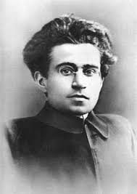
Political science introduction lecture 4
Critical theory
Gramsci and the Frankfurt School
Antonio Gramsci (1891 - 1937) philosopher, journalist and politician; founder and leader of the Italian Communist Party, who died shortly after being released from fascist’s prison, reflected on the recent developments in his home country Italy, a major figure in history of philosophy and cultural studies in the 20th century.
asked about class consciousness;
pent beyond mechanistic determinism of Marxism;
developed the theory of hegemony.

Slide 8
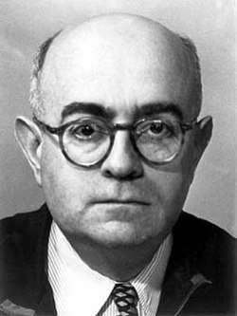
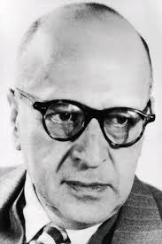
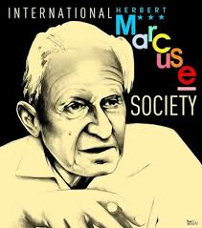
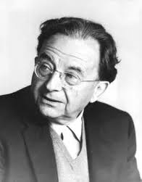
Political science introduction lecture 4
The Frankfurt School combined Marxism, Freudianism and Hegelianism
Adorno, Horkheimer, Marcuse, Fromm
bourgeois society
impossible to imagine anything else
role the media and popular culture
cult of consumption

Slide 9
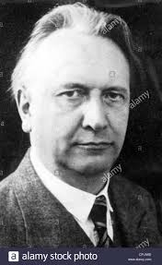
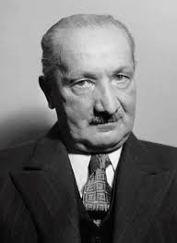
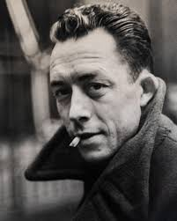
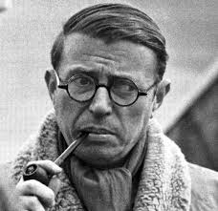
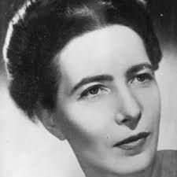
Political science introduction lecture 4
Existentialism - philosophy of the mid-20th century focusing on the uniqueness of human being/existence - methodologically, existentialism derives from both Kierkegaard and Freud.
Jaspers, Heidegger, Albert Camus, Jean-Paul Sartre, Simone de Beauvoir
This philosophy again rejects the optimism of the Enlightenment with its reliance in technological progress, but unable to give anything to ease unsettledness of human life, the inherent sense of fear, despair, and hopelessness.

Slide 10
Political science introduction lecture 4
Post-structuralism, Post-modernism
Emerged in France the early 1970s and gained its momentum in the 1980s in the United States, and in the 1990s spread to Europe.
Foucault, Lacan, Deleuze, Derrida, Baudrillard
Post-structuralist and post-modernist epistemology rejects:
notion of progress;
notion of attainable true knowledge
the notion of integrity, entirety and wholeness
concept of "self“ as a construct comprising conflicting knowledge claims
identities (e.g. gender, class, profession, etc
pluralism of “truth”.
Nietzsche: “facts do not exist, only interpretation”

Slide 11
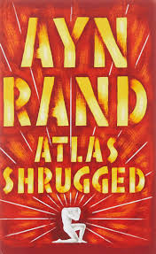
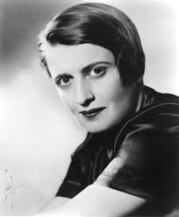
Political science introduction lecture 4
Objectivism and libertarianism
Ayn Rand
(born Alisa Zinovyevna Rosenbaum 1905 –1982)
laissez-faire capitalism as a system necessary for full realization individual rights including property rights;
close to the Austrian (and later Chicago) school of economic neo-liberalism dominant during R. Regan and M. Thatcher;
Rand’s Objectivism: “the man with the only moral purpose of his life being happiness and reason as the only absolute.
Rand: “individual should exist for his own sake, neither sacrificing himself to others nor sacrificing others to himself".

Slide 12
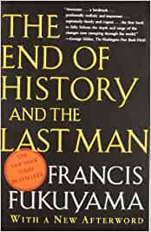
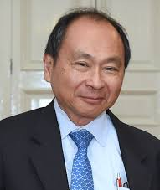
Political science introduction lecture 4
The End of History
End of History and the Last Man by Francis Fukuyama (1992):
the endpoint of the sociocultural evolution of mankind and the formation of the final form of government;
the end of ideological confrontations, global revolutions and wars;
- spread of Western-style liberal democracy and free market capitalism in the world;

Slide 13
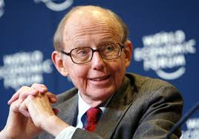
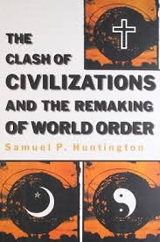
Political science introduction lecture 4
The Clash of Civilizations (1993) by
Samuel P. Huntington
Part 1 talks about the world of civilizations
Part 2 discusses the shifting balance of civilizations
Part 3 claims that the Order of Civilizations is emerging
Part 4 focuses on the clash of civilizations
Part 5 is devoted to the future of civilizations
the clash of civilizations,
for Huntington,
represents a development in history

Slide 14
Political science introduction lecture 4
Return of moral philosophy
Michael Sandel - American political philosopher- professor of Government Theory at Harvard University Law School – author of the books:
Liberalism and the Limits of Justice
Liberalism and Its Critics
Democracy’s Discontent: America in Search of a Public Philosophy
Public Philosophy: Essays on Morality in Politics
The Case against Perfection: Ethics in the Age of Genetic Engineering
Justice: What’s the Right Thing to Do?
What Money Can’t Buy: The Moral Limits of Markets
The Tyranny of Merit: What's Become of the Common Good?

